Slide 1

DESIGN THINKING
GROUP 4
Aishwarya Pradeep
Niraj Chaudhari
A. Malvika
Ayan Dutta
Atharva
Bandi Shravanthi

Slide 2

Table of contents
01
02
03
04
05
06
Change
Organization
WHY LIFESTYLE
What change our product is bringing about
About our organization
Finding the problem/posibility
Solutions
Problem statement 1
Problem statement 2

Slide 3
Table of contents
07
08
09
10
Prototypes
Feedback
Cost analysis
Feedback of consumers
11
Calendar
Business Model

Slide 4
01
Change

Slide 5
A self-checkout kiosk for a clothing store can bring several significant changes to the world:
Enhanced Shopping Experience: It can make the shopping process faster and more convenient for customers, reducing the time spent waiting in lines.
Increased Efficiency: Self-checkout kiosks can help stores optimize their staff allocation and reduce labor costs.
Reduced Theft: With improved security measures, these kiosks can minimize theft and shoplifting incidents.
Data Insights: They can provide valuable data on customer preferences and behaviors, enabling stores to tailor their offerings better.
Global Accessibility: Widespread adoption of such kiosks could make shopping more accessible to people with disabilities who might find traditional checkout processes challenging.
Pandemic Adaptability: In light of global health concerns, self-checkout kiosks can minimize human interaction and reduce the risk of disease transmission.

Slide 6
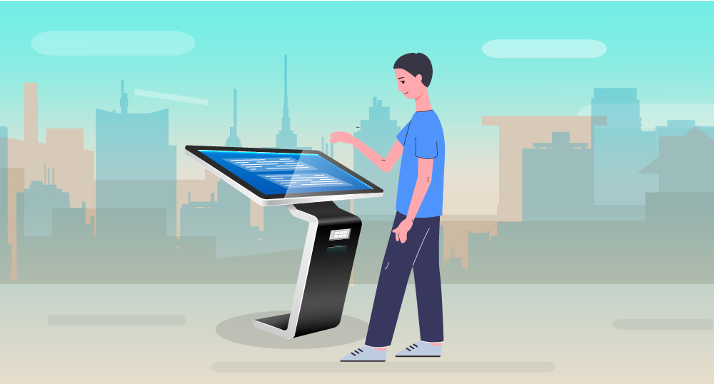
Environmental Impact: By reducing paper receipts and optimizing inventory management, these kiosks could contribute to sustainability efforts.
Business Expansion: Stores can potentially expand their operations with fewer physical checkout lanes, reaching more customers in different locations.
Overall, a self-checkout kiosk for a clothing store has the potential to streamline operations, improve customer satisfaction, and contribute to the evolution of the retail industry.

Slide 7
02
ORGANISATION

Slide 8


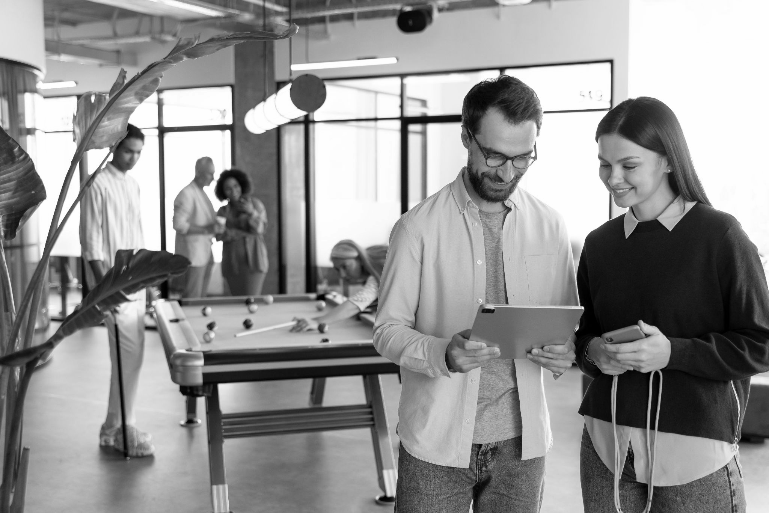

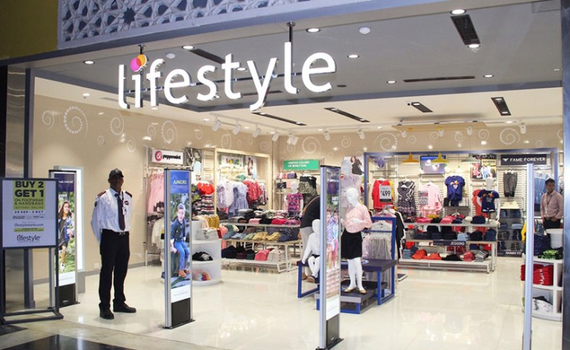
Our company
Lifestyle is a type of retail store that sells a wide variety of products related to lifestyle, including clothing, accessories, home decor, and beauty products. Originating in India in 1999, Lifestyle is a retail fashion brand that comes under the Dubai-based retail and hospitality conglomerate, the Landmark Group.

Slide 9
Our evolution
Lifestyle retail companies have evolved significantly over the years, in response to changing consumer needs and preferences.
Early
Experiential
Increasing competition
Lifestyle retail have also begun to integrate their online and offline channels so that consumers can have a seamless shopping experience regardless of how they choose to shop.
In the early days, lifestyle retail companies were primarily focused on selling products.
As consumers became more affluent and sophisticated consumers demanded a positive and engaging shopping experience.

Slide 10
03
WHY LIFESTYLE

Slide 11
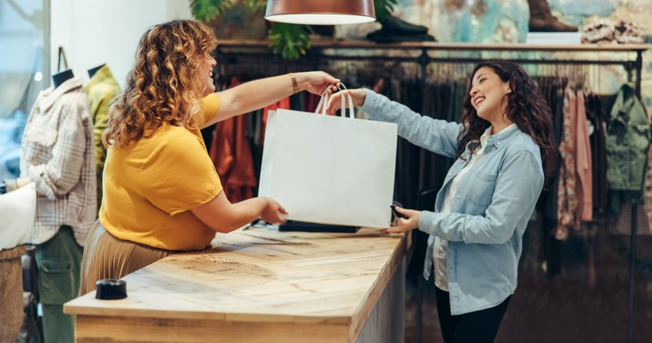
As students, we frequently visit Neeladri Road to shop. As Lifestyle is a one-stop shop for various utilities, we have previously visited this store and done shopping from there multiple times. We faced both good and bad experiences while shopping, so we decided to focus on this in our research and analysis.
In various corporate contexts, the principles and techniques utilized in lifestyle retail are frequently transferable. Studying a lifestyle retail store can aid in your comprehension of more general business ideas.
In conclusion, Lifestyle retail establishments play a significant role in contemporary consumer culture. They are a pertinent and relatable subject for study because they cater to a wide range of consumer demands and tastes.

Slide 12
04
PROBLEM STATEMENT 1

Slide 13
PROBLEM STATEMENT 1
How might we resolve the issue of customer experience and customer satisfaction at Lifestyle?
(Decrease the customers’ required time on the billing counter)

Slide 14
05
PROBLEM STATEMENT 2

Slide 15
PROBLEM STATEMENT 2
How might we resolve the issue of increasing competition among fellow competitors to become the most preferred retail store?

Slide 16
06
SOLUTION

Slide 17

Modify the store layout to create additional checkout counters on each floor or redesign the self-checkout interface to make it more user-friendly and intuitive.

Slide 18
Add more self-checkout kiosks to reduce the waiting time of customers.

Slide 19
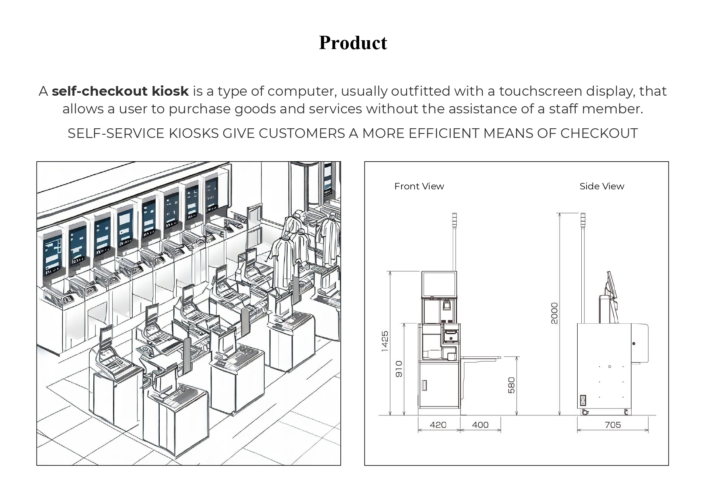

Slide 20
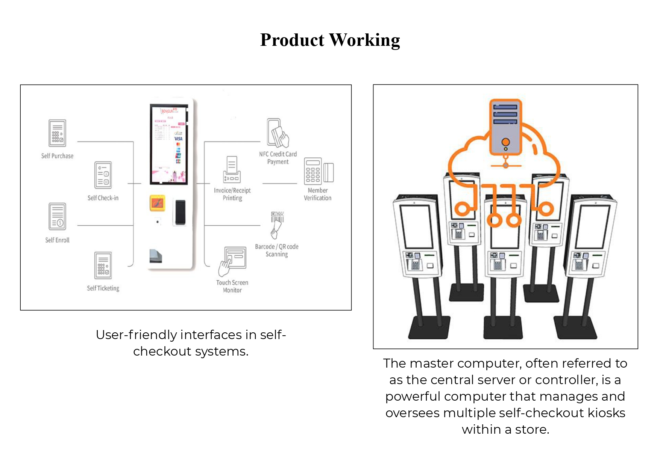

Slide 21
UNIQUENESS OF SOLUTION
Installing a kiosk at a lifestyle retail establishment can provide several special advantages, such as:
Customers can shop for goods and services more conveniently at kiosks without having to wait in queue or speak to a salesperson, thereby improving customer convenience. This might seem particularly enticing to customers who are pressed for time or like to shop alone.
Kiosks can be utilized to give clients a better overall retail experience by making their purchasing more interactive and engaging.

Slide 22
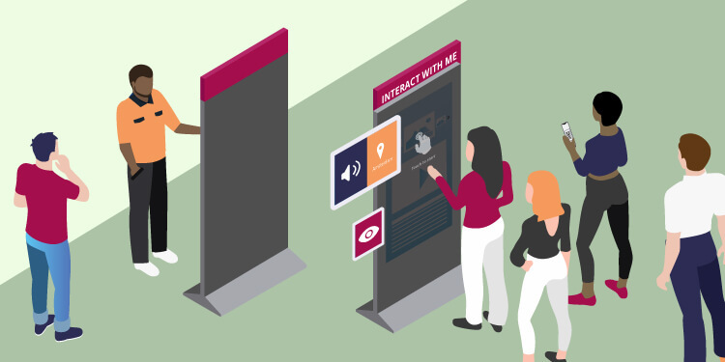
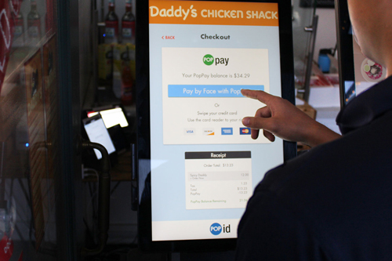
Reduced labour expenses: By automating procedures like checkout, customer assistance, and product information, kiosks can assist in reducing labour costs. This can free up staff members to work on other tasks, like fostering strong customer connections or offering tailored support.

Slide 23
07
PROTOTYPE

Slide 24
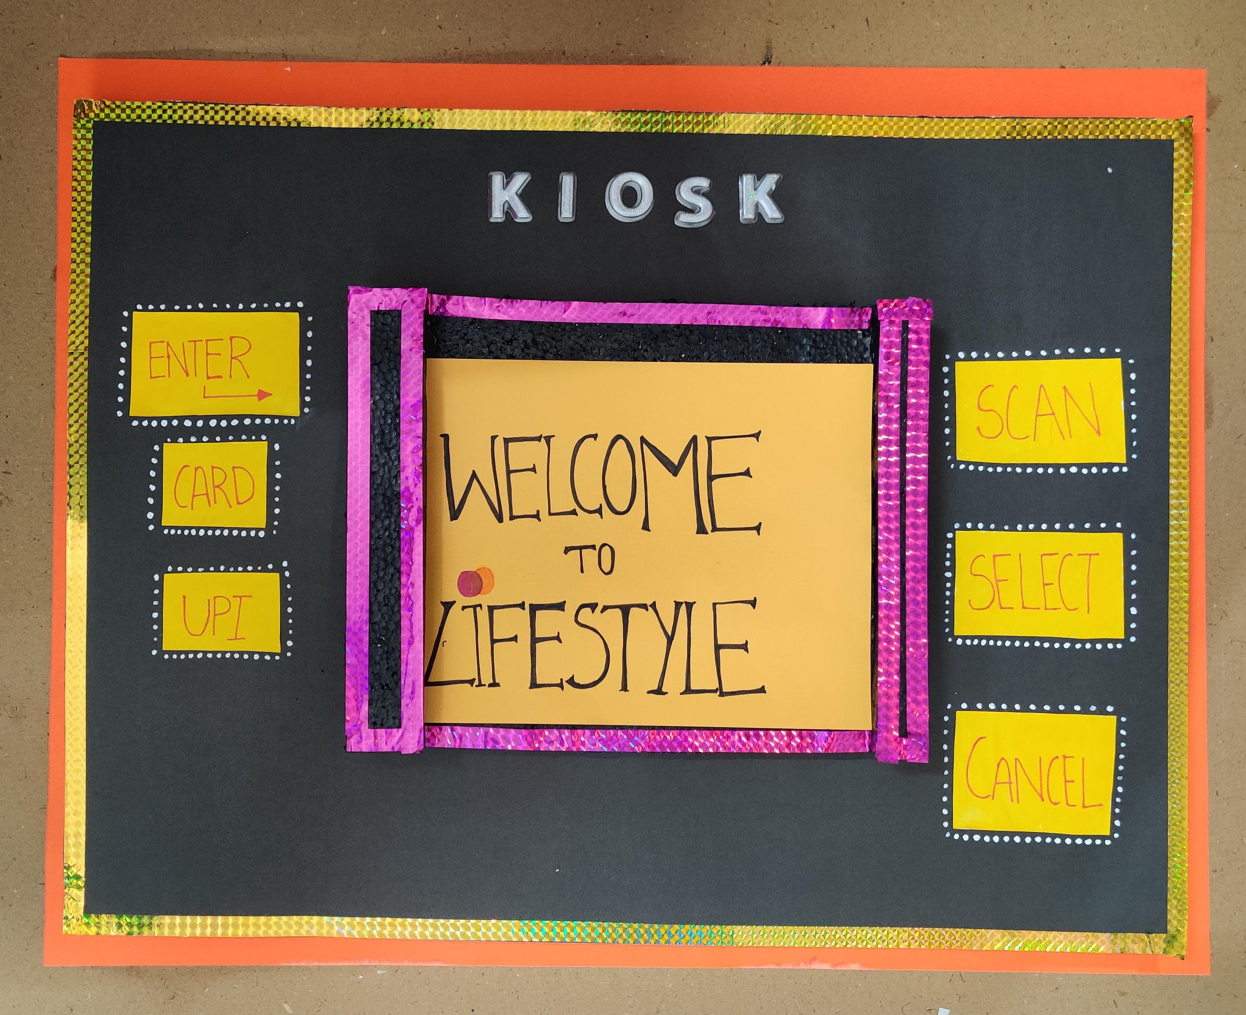

Slide 25
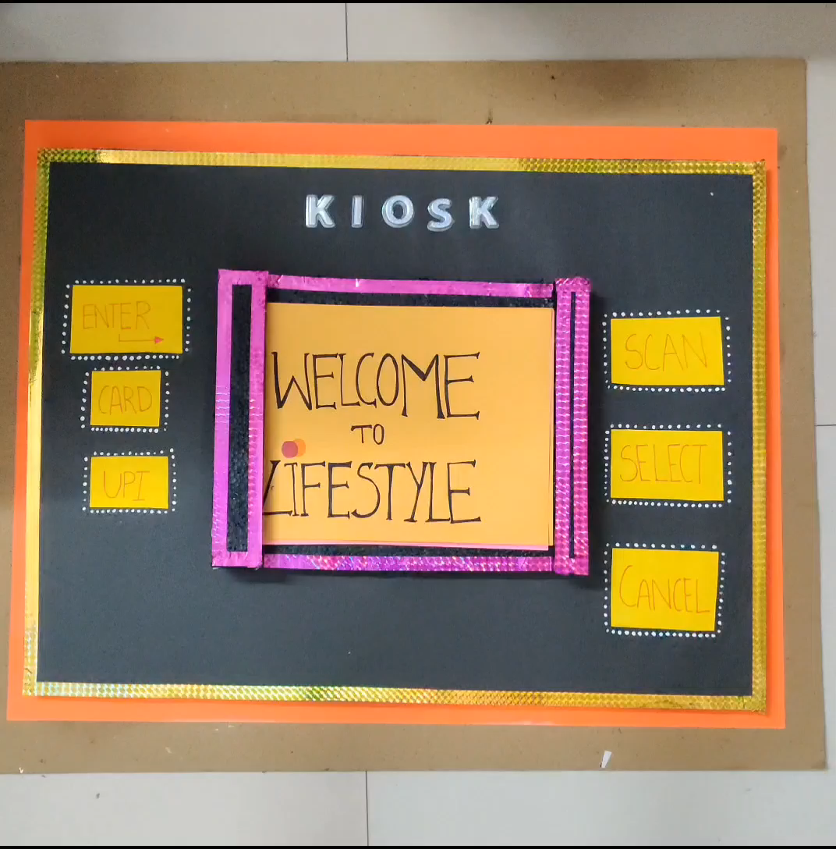
WORKING

Slide 26
08
CONSUMER FEEDBACK
CONSUMER FEEDBACK

Slide 27
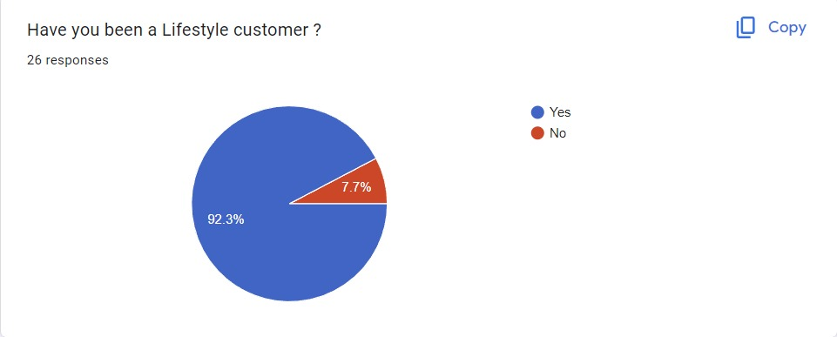

Slide 28
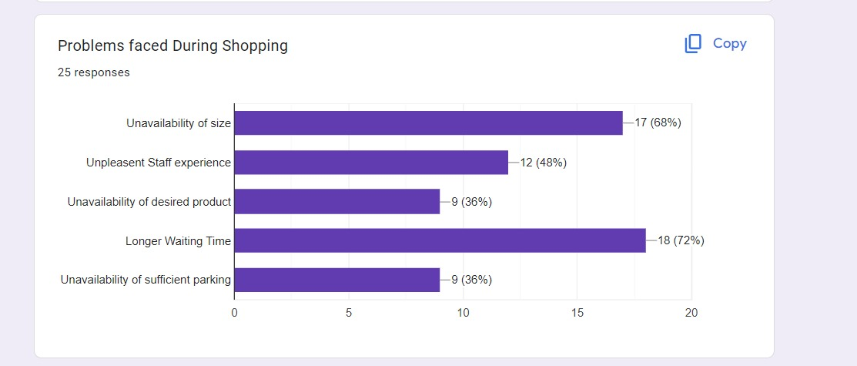

Slide 29
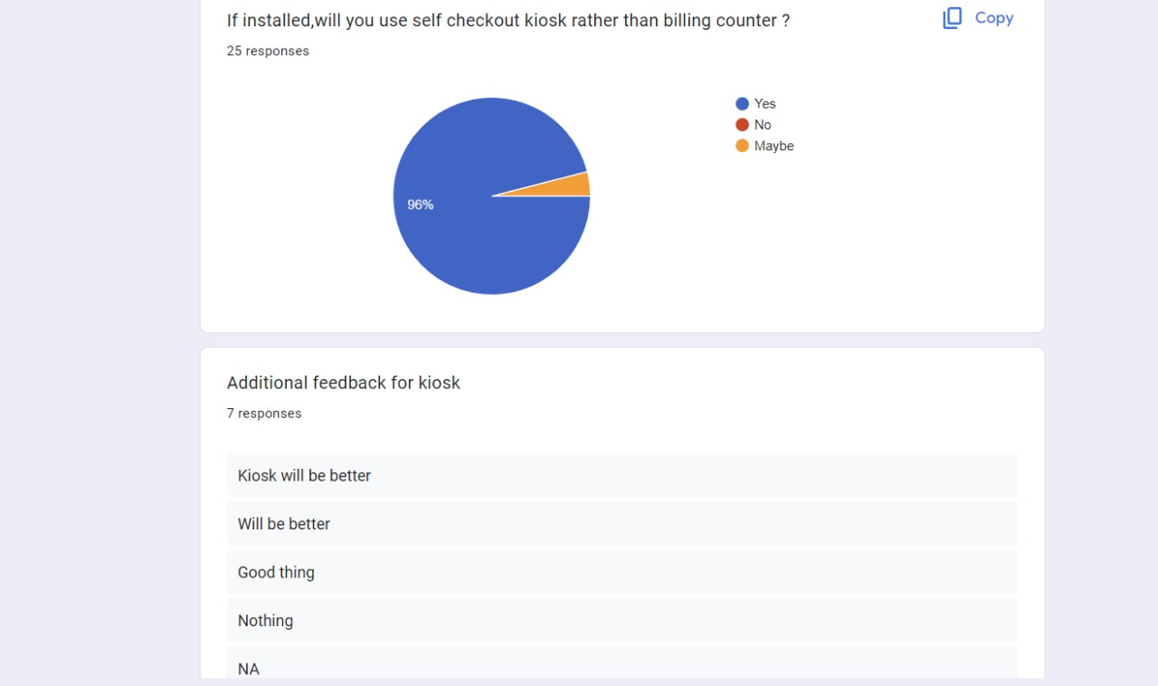

Slide 30
09
COST ANALYSIS

Slide 31
COST ANALYSIS
Kiosk = 1.5 lakhs (approx).
A basic kiosk software with features such as content management and user authentication might cost around ₹10,000, while high-end kiosk software with features such as payment processing and product dispensing might cost around ₹50,000.
The cost of transporting a self-checkout kiosk can range from around ₹1,000 to ₹10,000.
A small kiosk with low bandwidth requirements might cost around ₹500 per month, while a large kiosk with high bandwidth requirements might cost around ₹2,000 per month.
Maintenance cost = 3000 to 5000
Total Cost = 220000 per kiosk.

Slide 32
10
Calendar

Slide 33
Observation-1 day- 20th July
Problem identification-2 days- 22nd July
Solution generation- 8 days- 31st July
Solution evaluation(choosing most likely to be successful solution)- 2 days- 2nd August
Solution implementation-8 days- 10th August
Solution monitoring-4 days- 14th august

Slide 34
11
BUSINESS MODEL

Slide 35
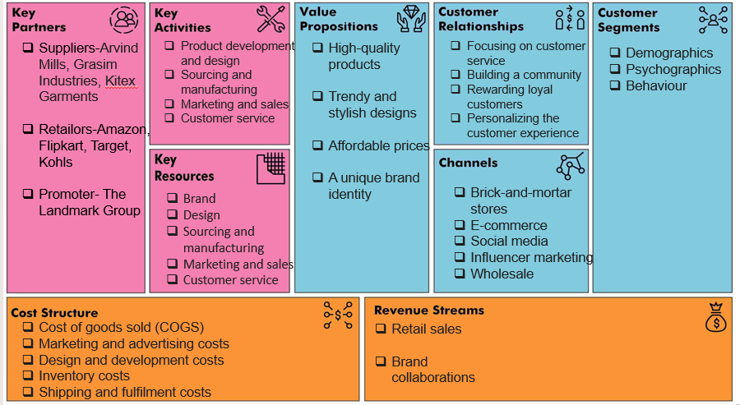

Slide 36
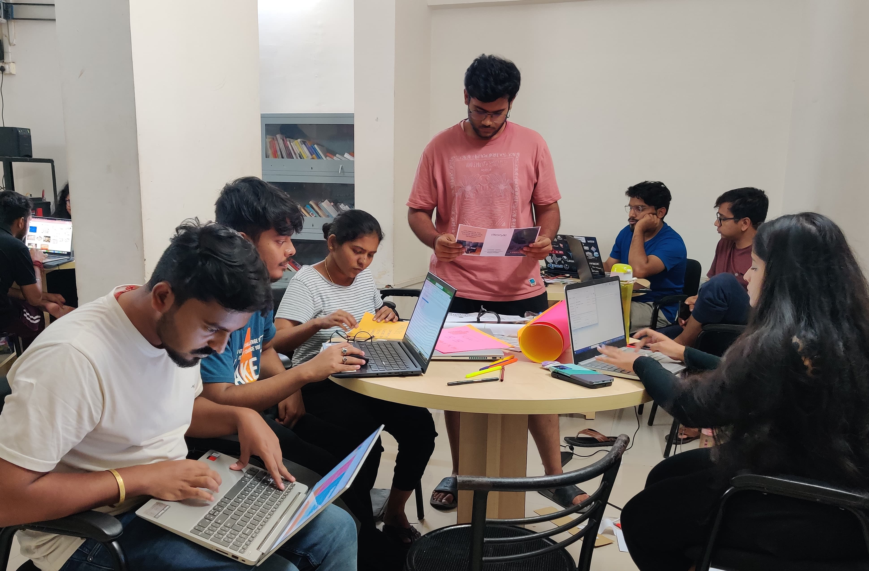

Slide 37




THANK YOU!!

